Slide 1
Domain: Cloud Computing
Technology: Python
<TEXT AND IMAGE ENCRYPTION DECRYPTION USING AES ALGORITHM

Slide 2
Index:
Abstract
Introduction
Literature review
Existing Method
Drawbacks
Proposed method
Advantages
Applications
Hardware and Software Requirements
References

Slide 3
Abstract :
Fast evaluation of digital data exchange occurs in recent years. Due to that security of information is much important in data storage and transmission process. Security of internet banking account passwords, email accounts password etc. requires text protection in digital media. In the same way image transmission and storage during industrial and research processes requires image protection. Images have large data size and also has real time constrain problem hence similar method cannot be used to protect images as well as text from unauthorized access. However with few variations in method AES can be used to protect image as well as text. In this application I have implemented encryption and decryption for text and image using AES.

Slide 4
Introduction:
Now a day’s the uses of devices such as computer, mobile and many more other device for communication as well as for data storage and transmission has increases. As a result there is increase in no of user’s also there is increase in no of unauthorized user’s which are trying to access a data by unfair means. This arises the problem of data security. To solve this problem a data is stored or transmitted in the encrypted format. This encrypted data is unreadable to the unauthorized user. Cryptography is a science of information security which secures the data while the data is being transmitted and stored.

Slide 5
In case of asymmetric key cryptography two different keys are used for encryption and decryption.
Symmetric key algorithm is much faster and easier to implement and required less processing power as compare to asymmetric key algorithm.
The advance encryption standard (AES) specifies a federal information processing standards publication (FIPS) approved cryptographic algorithm that can be used to protect electronic data.

Slide 6
Literature review:
S. NO | Journal Type with year | Authors | Title | Outcomes
1 | PEARSON, pp. | William Stallings | Advance Encryption Standard | Describes the basics of AES
2 | IEEE Transaction (1999) | AtulKahate | Computer-based symmetric key cryptographic algorithm | Discussed on cryptographic algorithms.
3 | International Journal of Engineering and Advance Technology (IJEAT) volume-1 | Manoj .B,Manjula N Harihar | Image Encryption and Decryption using AES | Image encryption and decryption project.

Slide 7
Existing method:
It was publish by National Institute of Standard and Technology (NIST) in 2001 developed by Joan Daemen and Vincent Rijmen, an algorithm called Rijdael[2]. Tages over 3DES such as high computational efficiency, 128-bit block size and cryptanalysis resistance is strong against differential truncated differential, linear, interpolation and square attacks [1][9]

Slide 8
Disadvantages in Existing method:
Low accuracy.
Does not performs well in different conditions the what these are trained on.
Low scalability

Slide 9
Proposed method:
AES algorithm is of three types i.e. AES-128, AES-192 and AES-256. This classification is done on the bases of the key used in the algorithm for encryption and decryption process.
The numbers represent the size of key in bits. This key size determines the security level as the size of key increases the level of security increases.
The AES algorithm uses a round function that is composed of four different byte-oriented transformations. For encryption purpose four rounds consist of:
• Substitute byte
• Shift row • Mix columns
• Add round key

Slide 10
While the decryption process is the reverse process of the encryption which consists of:
• Inverse shift row
• Inverse substitute byte
• Add round key
• Inverse mix columns
There is a number of round present of key and block in the algorithm.
The number of rounds depends on the length of key use for Encryption and Decryption.

Slide 11
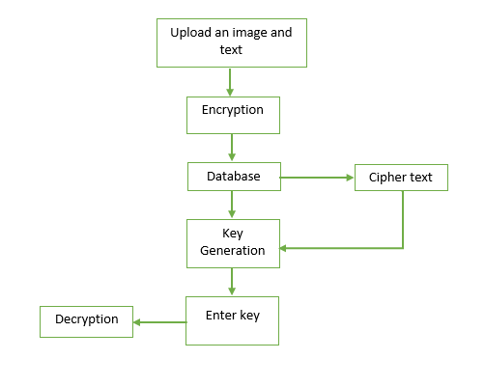
Proposed method:
Fig: Block diagram of Proposed Method

Slide 12
Advantages of Proposed method:
High accuracy.
Performs well in different conditions the what these are trained on.
Highly scalable model.

Slide 13
Applications of Proposed method:
Used by companies to store data securely.
Privacy based organizations uses them to improve security.

Slide 14
Hardware and Software Requirements:
H/W SPECIFICATIONS:
Processor : I3/Intel Processor
RAM : 4GB (min)
Hard Disk : 128 GB
Key Board : Standard Windows Keyboard
Mouse : Two or Three Button Mouse
Monitor : Any
S/W SPECIFICATIONS:
Operating System : Windows 7+
Server-side Script : Python 3.6+
IDE : PyCharm
Libraries Used : Pandas, NumPy,

Slide 15
References:
[1] William Stallings, “Advance Encryption Standard,” in Cryptography and Network Security, 4th Ed., India:PEARSON,pp. 134–165.
[2] AtulKahate, “Computer-based symmetric key cryptographic algorithm”, in Cryptography and Network Security, 3th Ed. New Delhi:McGraw-Hill, pp. 130-141.
[3] Manoj .B,Manjula N Harihar (2012, June). “Image Encryption and Decryption using AES”, International Journal of Engineering and Advance Technology (IJEAT) volume-1, issue-5, pp.290-294.
[4] KundankumarRameshwarSaraf, Vishal PrakashJagtap, Amit Kumar Mishra, (2014, May-June).”Text and Image Encryption Decryption Using Advance Encryption Standard”, International Journal of Emerging Trends and Technology in computer science(IJETTCS) volume-3, issue-3, pp.118-126.
[5] VedkiranSaini, ParvinderBangar, Harjeet Singh Chauhan, (2014, April).”Study and Literature Survey of Advanced Encryption Algorithm for Wireless Application”, International Journal of Emerging Science and Engineering ( IJESE) volume-2, issue-6, pp.33-37.

Slide 16
THANK YOU

